Slide 1


Seminário / Estrutura de Dados
Red-Black Tree
Carlos Pinheiro
Dayvson Sales
Ellena Oliveira
Victor Accete
Outubro/2016

Slide 2
Self-balancing trees
What if we could make a tree that rotates less than AVL but still is always balanced?
We saw that an AVL tree can:
Insert in O(logn)
Search in O(logn)
Is there a way to change the balancing rules so that we will make less rotations while inserting?

Slide 3
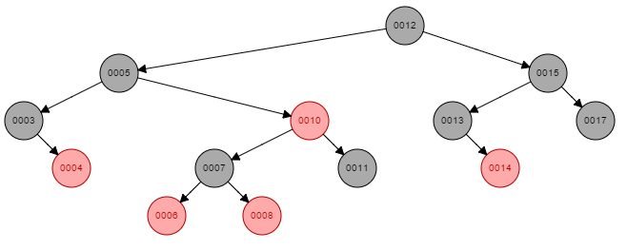
Red-Black Tree
Is a self-balancing binary search tree, like an AVL tree, but with different balancing rules and different properties
We will still have: - Search: O(logn) - Insertion: O(logn)

Slide 4
Red-Black Tree
Red-black trees are similar to AVL trees, but provide faster real-time worst case performance for insertion and deletion
The trade-off is a slightly slower (but still O(log n)) lookup time.

Slide 5
Properties
A node is either red or black
The root is black
Every leaf (NIL) is black (Sentinel)
If a node is red, then both its children are black – which implies that we can't have two adjacent red nodes
Every path from a given node to any of its descendant NIL nodes contains the same number of black nodes
To preserve these properties we will need to perform rotations ↺ and recolourings!

Slide 6
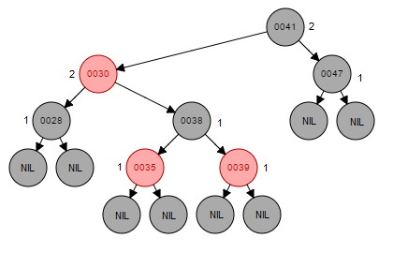
Quick definition
We call the number of black nodes on any simple path from, but not including, a node x down to a leaf the black-height of the node, denoted bh(x)

Slide 7
Structs
#define NIL tree->nil
#define ROOT tree->root
#define black 'b'
#define red 'r'
struct rb_node{
int key;
char color;
rbNode* parent;
rbNode* left;
rbNode* right;
};
struct rb_tree{
rbNode* root;
rbNode* nil;
};

Slide 8
Red-Black Tree ADT
rbTree* createTree();
void insertRB(rbTree* tree, int key);
void insertTree(rbTree* tree, rbNode* z);
void rotateLeft(rbTree* tree, rbNode* x);
void rotateRight(rbTree* tree, rbNode* y);
bool searchRB(rbTree* tree, int key);
void printPreOrder(rbTree* tree, rbNode* x);
void printInOrder(rbTree* tree, rbNode* x);
void printPostOrder(rbTree* tree, rbNode* x);

Slide 9
Insertion
void insertRB(rbTree* tree, int key){
/* Allocate new node, set key and color it to red
Insert in tree as a binary tree */
insertTree(tree, x);
/* fix while x->parent != tree->root and x->parent->color == red*/
while(x->parent->color == red){
if (x->parent == x->parent->parent->left){
/* x's parent is a left child, y is x's uncle*/
y = x->parent->parent->right;
/* Case 1: x's uncle is red */
if(y->color == red){
x->parent->color = black;
y->color = black;
x->parent->parent->color = red;
x = x->parent->parent;
} else{
/* Case 2: x's uncle is black and x is a right child */
if(x == x->parent->right){
x = x->parent;
rotateLeft(tree, x);
}
/* Case 3: x's uncle is black and x is a left child */
x->parent->color = black;
x->parent->parent->color = red;
rotateRight(tree, x->parent->parent);
}
} else /* Same as if with left and right exchanged */
}
ROOT->color = black;
}

Slide 10
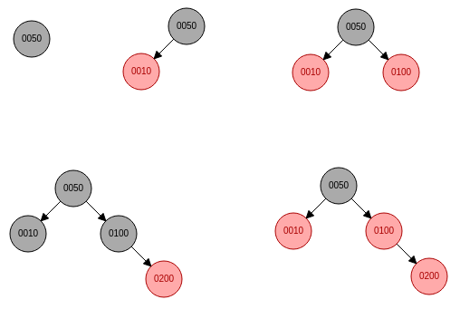
Insertion
insertRB(tree, 10)
insertRB(tree, 100)
insertRB(tree, 200)
Preserving properties by recoloring

Slide 11
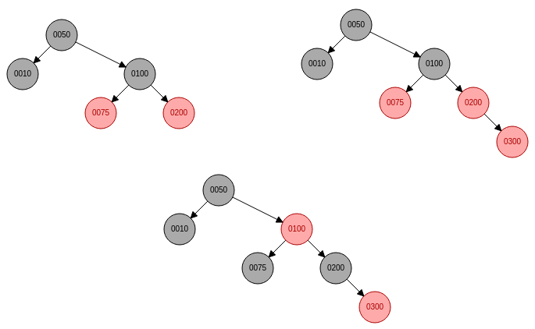
insertRB(tree, 300)
Preserving properties by recoloring

Slide 12
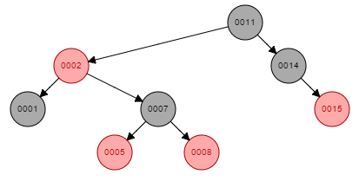
Insertion
An insertion that covers three cases
Let the node 11 below be tree root,
then insertRB(tree, 4);

Slide 13
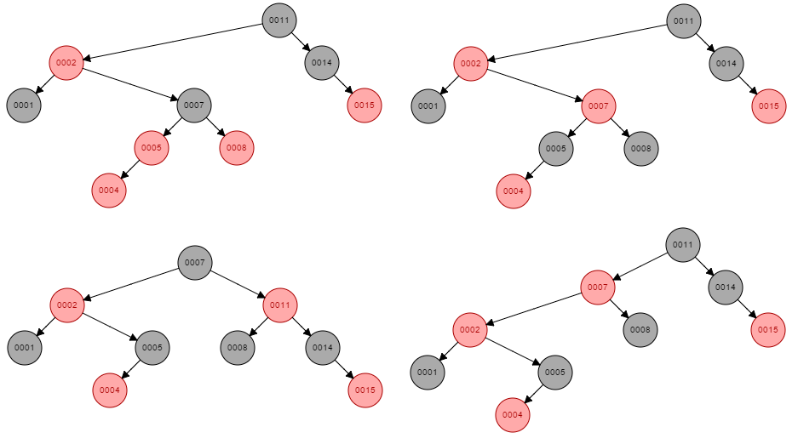
Case 1
y
x
y
Case 2
x
Case 3
y
x
x

Slide 14
So…
We’ve seen that AVL tree isn’t the only way to keep a binary search tree balanced
Red-Black trees also achieve that purpose, in a less rigid way!
The tree would be slightly less balanced, however, the insertion would be slightly faster

Slide 15
Where are RB Trees used?
RB Tree is probably the most popular self-balancing tree implementation
Java: java.util.TreeMap , java.util.TreeSet
C++ STL: map, multimap, multiset
Linux kernel: completely fair scheduler, linux/rbtree

Slide 16
References
Cormen, T. H.; Leiserson, C. E.; Rivest, R. L.; Stein, C.. Introduction to Algorithms. Cambridge: MIT, 2009.
https://www.cs.usfca.edu/~galles/visualization/RedBlack.html
https://www.cs.auckland.ac.nz/software/AlgAnim/red_black.html
https://ocw.mit.edu/courses/electrical-engineering-and-computer-science/6-046j-introduction-to-algorithms-sma-5503-fall-2005/video-lectures/lecture-10-red-black-trees-rotations-insertions-deletions/lec10.pdf

